Slide 1
C-ITS Platform
Urban Working Group – Additional Urban C-ITS Services

Slide 2
Recap: Outcomes of Meeting 1
Level | C-ITS Service | Score
Day 1 | TRAFFIC SIGNAL PRIORITY REQUEST BY DESIGNATED VEHICLES | 14
Day 1 | GREEN LIGHT OPTIMIZED SPEED ADVISORY GLOSA/TIME TO GREEN (TTG) | 12
Day 1.5 | TRAFFIC INFORMATION AND SMART ROUTING | 10
Day 1.5 | PARK AND RIDE INFORMATION | 9
Day 1 | ROAD WORKS WARNING | 6
Day 1 | IN-VEHICLE SPEED LIMITS | 6
Day 1 | PROBE VEHICLE DATA | 6
Day 1.5 | VULNERABLE ROAD USER PROTECTION | 6
Did not pass threshold*
Signal violation/intersection safety, On street parking information and management, Weather conditions, Information on AFV stations and charging points, Traffic jam ahead warning, Other hazardous notifications, In-vehicle signage, Off street parking information, Connected & Cooperative navigation into and out of the city, Slow or station vehicle(s), Emergency electronic brake light, Emergency vehicle approaching, Shockwave damping.

Slide 3
Categories of Additional C-ITS Services
1. New Urban Specific Services
2. Extended Functionality of Original List of Day 1/1.5 Services
3. Additional User Groups of Existing C-ITS Day 1/1.5 Services

Slide 4
Access Zone Management (restricted lanes, zones, tunnes/bridges, management of freight loading/unloading areas)
Temporay traffic light prioritisation for designated vehicles (large events like concerts, football games etc.) - subset of traffic light prioritisation of designated vehicles
Collaborative perception of Vulnerable Road Users (VRUs) - subset of VRU road user protection
On-street and off-street parking management - subset of on-street and off-street parking information
Collaborative Traffic Management - subset of connected, cooperative navigation into and out of the city
Public Transport Vehicle Approaching
Access management of speed (i.e. near schools or identified priority zones by local authority etc.) - subset of in-vehicle signage
GLOSA for cyclists

Slide 5
Access Zone Management (restricted lanes, zones, tunnes/bridges, management of freight loading/unloading areas)
Temporay traffic light prioritisation for designated vehicles (large events like concerts, football games etc.) - subset of traffic light prioritisation of designated vehicles
Collaborative perception of Vulnerable Road Users (VRUs) - subset of VRU road user protection
On-street and off-street parking management - subset of on-street and off-street parking information
Collaborative Traffic Management - subset of connected, cooperative navigation into and out of the city
Public Transport Vehicle Approaching
Access management of speed (i.e. near schools or identified priority zones by local authority etc.) - subset of in-vehicle signage
GLOSA for cyclists
- Service descriptions, roles and responsibilities, technical requirements defined in WG deliverables
- C-ITS Platform Phase II Report to include this set of extension of urban relevant C-ITS services (subject to June Plenary)

Slide 6

connected vehicles: the urban impact
THE CIMEC PROJECT
This project has received funding from the European Union’s Horizon 2020 research and innovation programme under grant agreement No 653637

Slide 7
CIMEC motivation
  Deployment barriers are not technical
  Deployment in cities is not keeping pace with the highways
  Deployment should happen in an open market place
  Deployment should be simple and integration automatic

Slide 8
CIMEC objectives
  Gain better understanding of the challenges, enablers and barriers, and strategies for use of C-ITS solutions in European cities
  Capture and document a set of realistic use cases for C-ITS in cities
  Identify how emerging standards for C-ITS will affect, and should respond to, the systems and processes in the urban environment
  Promote multi-sector stakeholder dialogue, engagement and collaboration

Slide 9
City perspective on C-ITS
  What cities want:
    To reduce congestion
    To improve the environment – specifically regarding air pollution
    To maintain safety on the network
    To improve accessibility by promoting excellent public transport (partly to support the above goals)

Slide 10
City perspective on C-ITS
  Cities lack knowledge about:
    What products are available
    Which products will work with each other, or with the systems that will be acquired by road users
    The cost of acquiring or operating products

Slide 11
City perspective on C-ITS
  Cities need to be convinced that the technology:
    Is available and meets the specification
    Will do the job better than another (cheaper) solution
    Is well tested to achieve the outcome desired
    Is well tested to be safe in the context
    Is a price which is manageable within the budget
    Will integrate with the city’s own legacy systems
    Is future-proofed against obsolescence

Slide 12
Urban C-ITS use cases
  C-ITS use cases with potential for cities:
    Identified through workshops and surveys involving local city authorities and stakeholders
    Supplemented with relevant use cases from the other projects
    Mix of general and more specific categories, with some overlap

Slide 13


Urban C-ITS use cases
Information to road users
ℹ
🚧
UC1: Individual routing of vehicles
UC2: In-vehicle signs
UC3: In-vehicle signal information
UC12: Inform about incidents in the road network and access control to these areas
UC13: Inform about emergencies in the road network and access control to these areas
Traffic light management
UC8: Traffic light management
UC7: Green lights for police and emergency vehicles
UC9: Green lights for public transport vehicles
UC10: Green lights for cyclists
Access control
UC5: Access control for heavy goods vehicles with dangerous goods
UC6: Regulation of access to free lanes for electrical vehicles
UC14: Dynamic access control for air quality management

Slide 14


Urban C-ITS use cases
🚶
🚲
Vulnerable road users (VRUs)
UC10: Green lights for cyclists
UC15: Speed enforcement around schools
UC16: C-ITS services for vulnerable road users
UC17: Pedestrians crossing in front of bus/tram
UC18: Bike lane change and unusual crossing
Parking management
UC11: Parking management

Emergency vehicles
UC7: Green lights for police and emergency vehicles
Freight vehicles
UC4: Management of loading and unloading areas for freight vehicles
UC5: Access control for heavy goods vehicles with dangerous goods

Slide 15
recommendations for Cities
As soon as realistic C-ITS products become available:
  Start working on a strategy for optimizing C-ITS potential by means of:
  Communication channels
  Roadside units
  Central data bases
  Open data feeds
  shared technology platforms
  shared approach for business models
  Role of suppliers of:
  technology
  data
  services

Slide 16
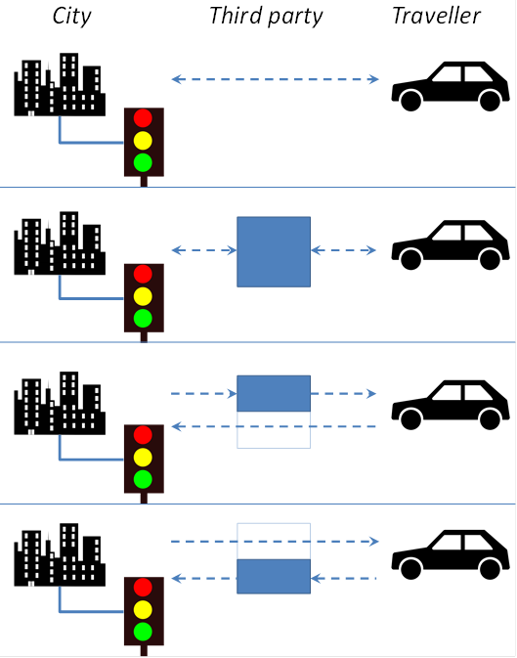
Business models
City collect data and provide service directly to the road user, using its own technology - No third party involved
Third party collect data and provide service - No direct city involvement
Third party provide service on behalf of city - city collect data for own use
Third party collect and provide data to the city - city provide service to the road user
  Feasibility; political, technical and commercial
  Utility; to road users and city managers
  Social and legal issues - privacy

Slide 17
Understanding the costs
  Cost of acquiring (or upgrading) roadside devices
  Cost of installing and commissioning roadside devices
  Cost of acquiring (or upgrading) central systems, including the additional cost of integration of roadside devices
  (Additional) cost of the city’s communication network between centre and roadside; also possibly additional costs of electricity supply
  Cost of acquiring and/or training staff to use the system
  Cost of maintenance, repair, upgrade and replacement of system elements
  Any direct contribution to the cost of in-vehicle systems – in the case of city vehicles, the whole cost
  Cost of marketing to prospective road users
  Cost of technical support to actual road users
  Potential costs associated with consequences such as complaints and claims

Slide 18
Supplier READINESS
  In general suppliers see potential in city C-ITS...
  A few key suppliers have a clear vision and an action plan for deployment
    And they don’t reveal much information!
  Most have no well-defined plan – investment in product development will be limited as long as:
    Their current ITS-market position is not in danger
    There is no clear business case for city C-ITS
    They still face too many challenges (technical, political, legal, etc.)

Slide 19
Risk
  Breach of privacy
  Accident liability
  Political risk (e.g. through poor public reception)
  Supply failure
  Imposition of excessive costs or other burdens on road users
  Operational inadequacy (e.g. through shortage of skilled staff)

Slide 20
External factors
  Automated/autonomous vehicles
    degree of interaction with C-ITS
    city role: control or merely inform the vehicle?
  Personal smart devices
    Intelligent Mobility (IM)
    Mobility as a Service (MaaS)
  Smart cities
    Broader city strategies for use of technology - transport being one area
    "Internet of Things" (IoT)
  Newer transport modes
    Powered two-wheelers (PTW)

Slide 21
The wider context
Legal developments
Private sector developments
Evidence of benefits
Support mechanisms
  Cities’ future obligations to implement specific C-ITS services, and specifications of these services
  Support arrangements to ensure coherence, and long term stability of these
  Vehicle telematics
  Vehicle autonomy
  Smart personal devices
  Sustainability
  Cost-efficiency
  Funding
  Implementation

Slide 22
Recommendations for authorities
Establish base of evidence for benefit from urban C-ITS
Support and ensure coordination and communication involving cities, advisers and suppliers
  projects
  pilots
  European level
  National/regional level
  Harmonised city approach to C-ITS
  a market for urban C-ITS

Slide 23
Our partners

Slide 24
Thank you!

